Slide 2
Value-based smart reminders
Finding appropriate moments for
notifications in smart reminder systems
Notes:
Thank you all for being here
Rather than ending with it, I would first like to thank supervision Birna van Riemsdijk, Willem paul brinkman & Myrthe Tielman
Road long, switched studies twice, worked for three years, dancing, many championships: nationals, european, worlds
After almost 10 years of studying, finally standing in front of you.
Grandma
Topic @ interactive intelligence
Remembering the little things, like closing and locking all doors before sleeping.

Slide 3
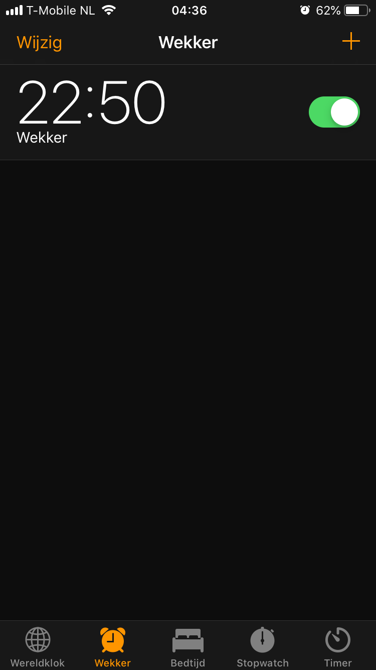
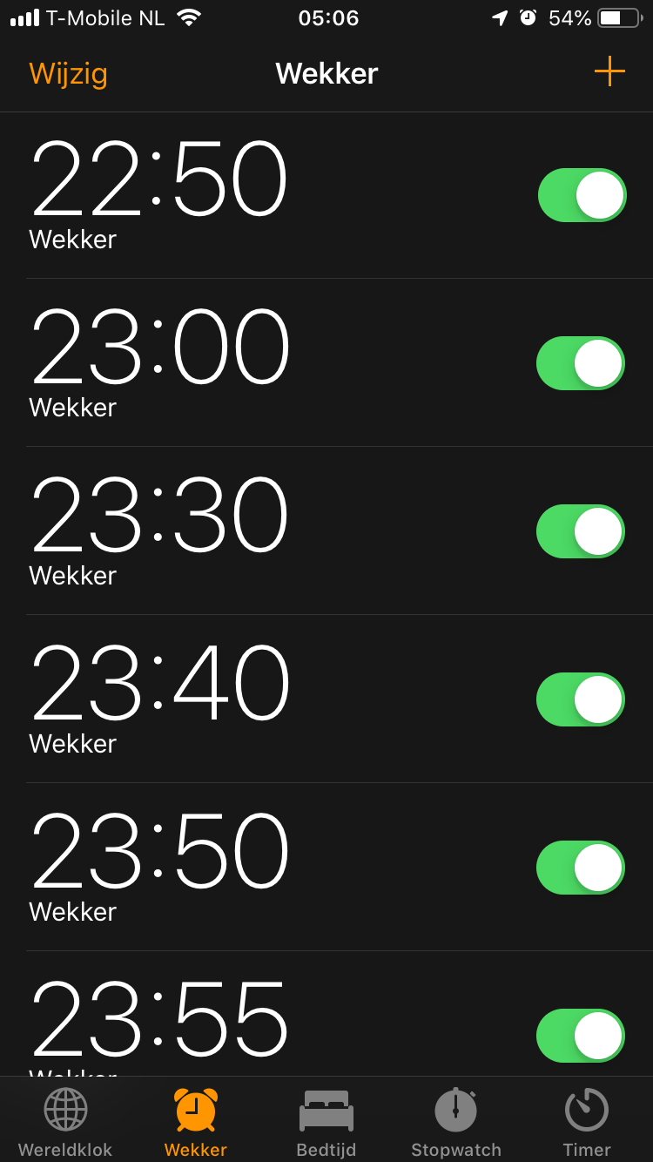
Value-based smart reminders
Finding appropriate moments for
notifications in smart reminder systems
Notes:
Simple solution alarm, which would maybe work
My case
----NEXT----
Ultimately leads to

Slide 5
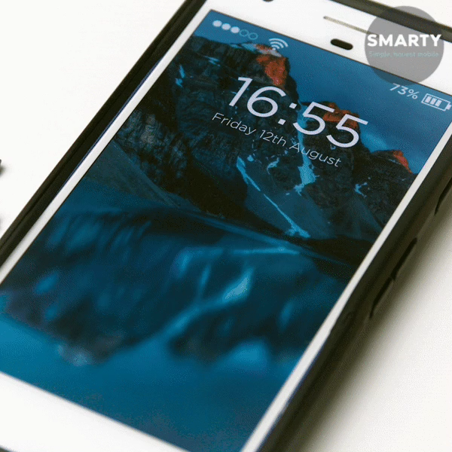
Notes:
Phone looking like this.
People who know me -> this is like my phone -> don’t respond quickly
Rather than being overloaded.
You want that right notification at the right time.
So basically like a mom.

Slide 6
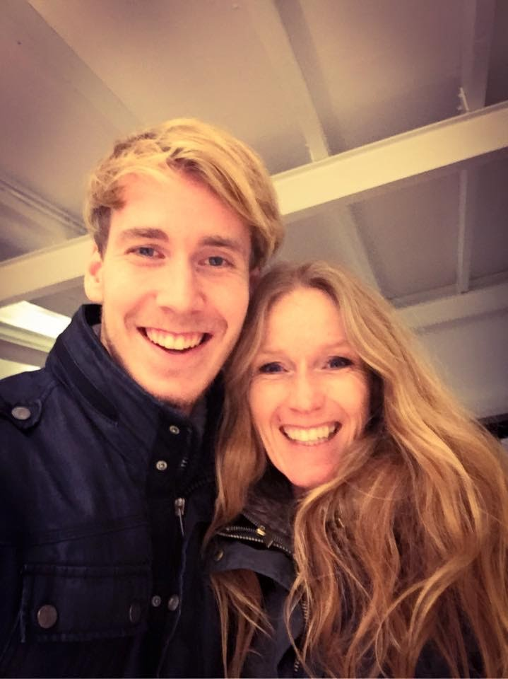

Notes:
”Sweetie, don’t forget to…”
(sorry mam)
Always right reminder at the right time. Why?

Slide 7
Values

Slide 8
Values

Slide 10
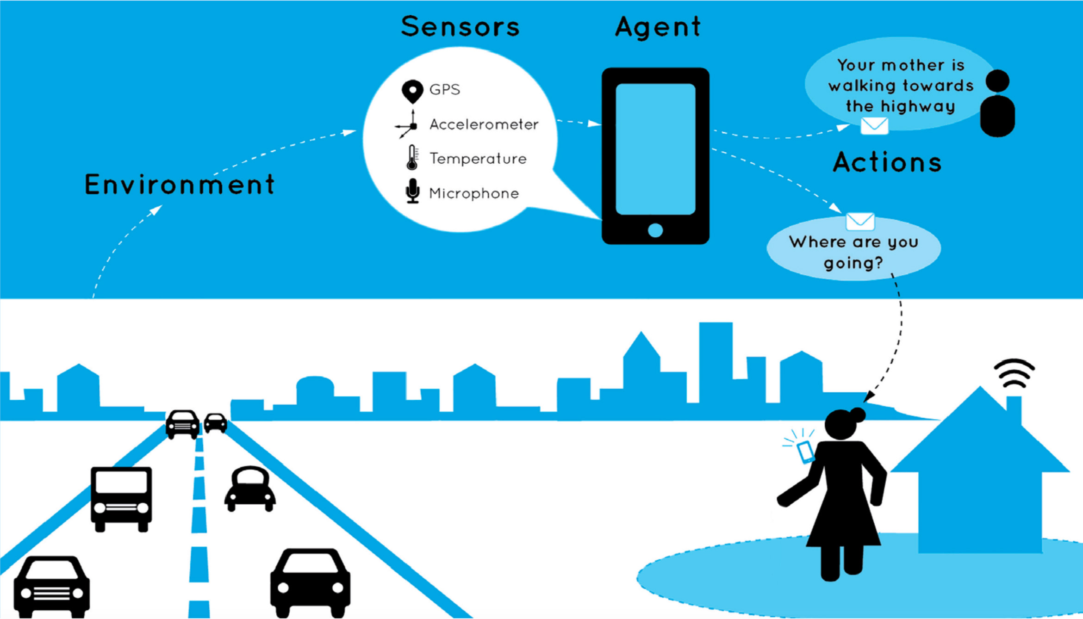
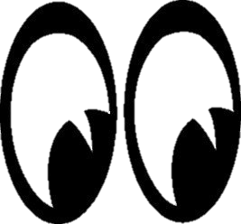
Notes:
Values from original supervisors
SAEP – socially adaptive electronic partner.
Used in support, eg. Alzheimer patients
Now: data user/environment
Rigid structure, not taking into account privacy, norms and values

Slide 11
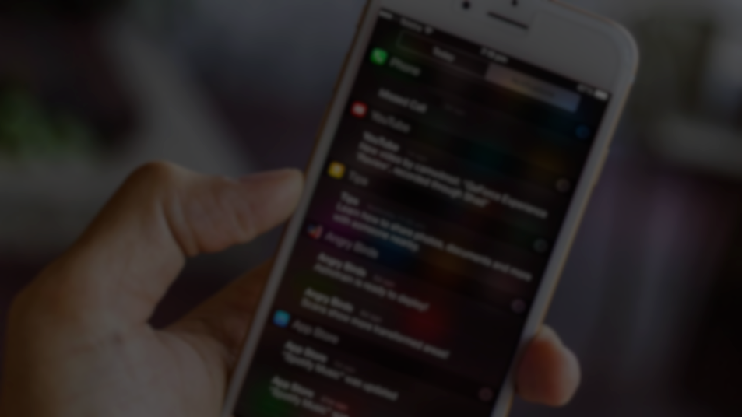
When to notify?

Slide 12
When to notify?
Notes:
Goal: to find a moment when to notify
Specifically, through the use of values.

Slide 13
When to notify?
How can a smart reminder system be extended to incorporate user
values to provide more appropriately timed notifications?
Notes:
Take existing prediction concept and extend it with values
Most appropriate = most value increase

Slide 15
Notes:
Take existing prediction concept and extend it with values

Slide 16

What don’t we want
What do we need?
Design time
Specific setup
Non-reproducible

Slide 17
What don’t we want
What do we need?
Design time
User’s past activities
Specific setup
Predict future activities
Non-reproducible
Connect values to activities
Combine all to
select moment

Slide 18
What don’t we want
What do we need?
Design time
User’s past activities
Specific setup
Predict future activities
Non-reproducible
Connect values to activities
Combine all to
select moment
NotiVal
Introducing

Slide 19
NotiVal
Introducing

Slide 20
Watching TV – Promotes Happiness
Do work – Promotes Career
07:45
8:15
08:00
09:00
Brushing teeth – Promotes Health
Eating – Promotes Health
Notes:
Assumptions: Explain that we have this in dataset or will still collect through an app
Activities directly promoting/demoting values
Notification might not ruin value, requires separate data.
Find least annoying.

Slide 21
Watching TV – Very Annoying
Do work – Unacceptable
07:45
8:15
08:00
09:00
Brushing teeth – Slightly Annoying
Eating – Slightly Annoying
Notes:
Assumptions: Explain that we have this in dataset or will still collect through an app
Activities directly promoting/demoting values
Notification might not ruin value, requires separate data.
Find least annoying.
Fins latest

Slide 22
?

Slide 23
Activity prediction
?
Notes:
Many options
Clustering and data mining to find temporal relations

Slide 24
Activity prediction

Slide 25
Activity prediction

Slide 26
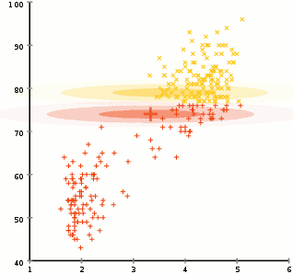
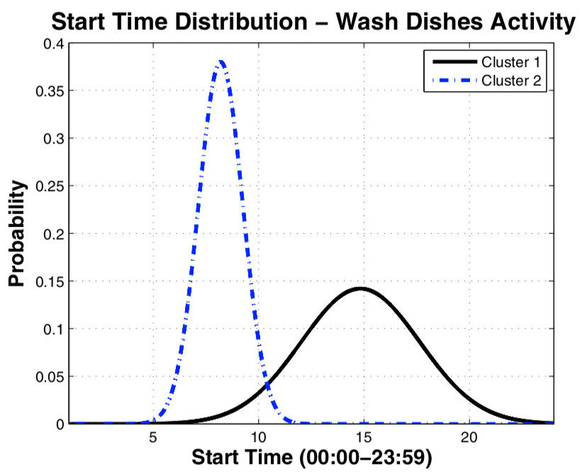
Expectation Maximization
& Apriori algorithm
Watching TV
57 %
Leaving Home
20 %
Watching TV
40 %
Showering
55 %

Slide 28
Expectation Maximization
& Apriori algorithm
Watching TV
57 %
Leaving Home
20 %
Watching TV
40 %
Showering
55 %
Notes:
Two concepts from ML
Expectation Maximization – iterative method to find best parameters for Gaussian mixture models
Apriori algorithm (datamining algorithm) to identify temporal relations
Every cluster has probability of next activity

Slide 29
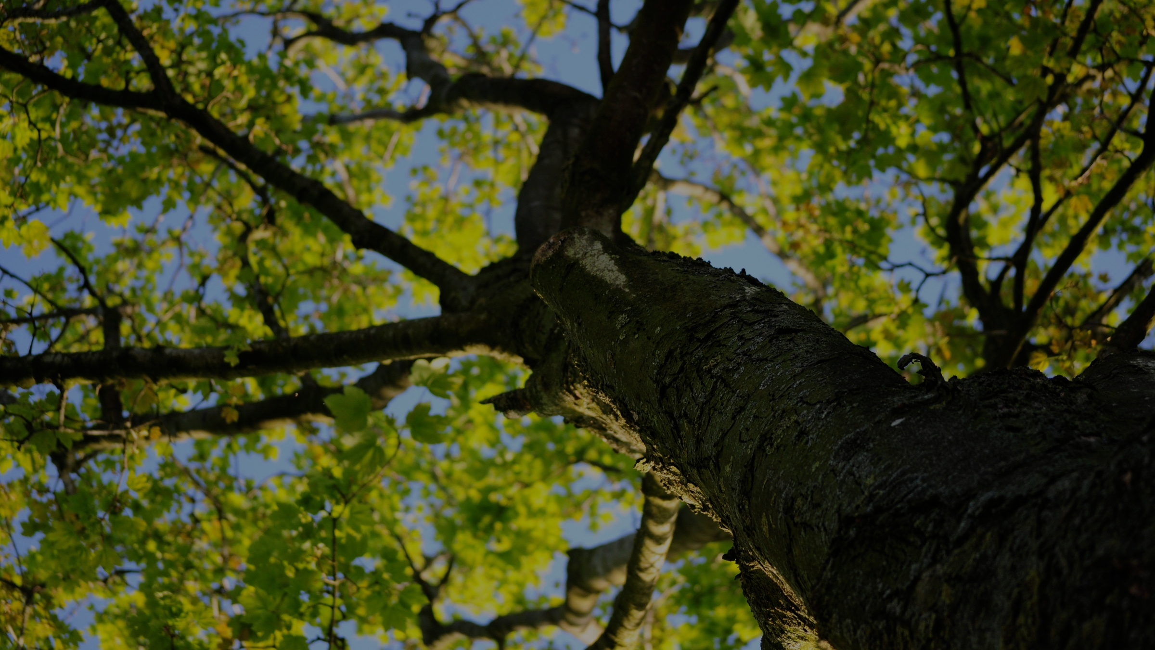
Expectation Maximization
Duration (min)
Start (h)

Slide 30
Notes:
Typical day modeled with these consecutive predictions

Slide 31
G
L
G
L
G
L
G
L
G
G
L
L
G
L
G
L
G
L
G
L
G
G
L
L
G
L
G
L
G
L
G
L
G
L
Notes:
Add values

Slide 32
Notival
Don’t forget to take your umbrella/walking stick/keys

Slide 33
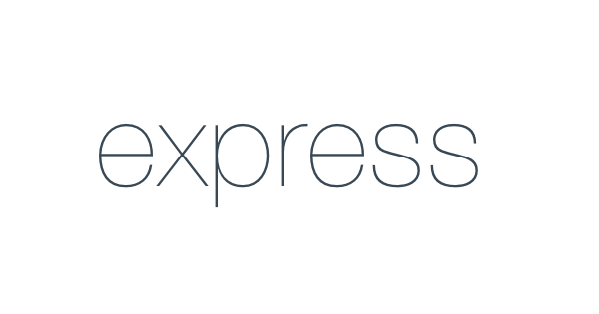
Notes:
Why do we have this? Any service or dataset

Slide 35
Value-based smart reminders
Finding appropriate moments for
notifications in smart reminder systems

